Slide 1
Hi.
I’m Terrible At Presentations...

Slide 2
An Easy 10 For JavaScript Kind Of

Slide 3
A Standard Pie Chard Who’s Important?

Slide 4
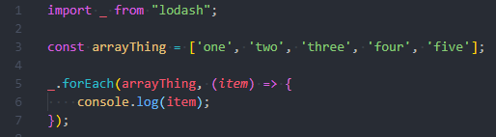
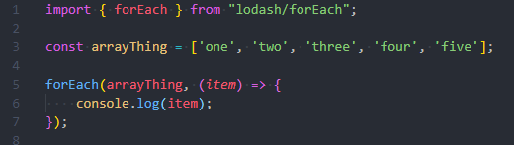
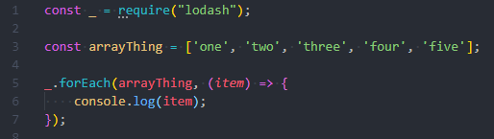
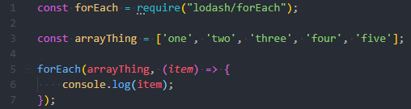
1. Imports
Hmm…
Better
Notes:
There’s no need to import a whole library
Whole library results in a bigger bundle size
Import only what you need
Importing whole libraries can be less readable
One benefit to a whole library import is the import sits on a single line

Slide 5
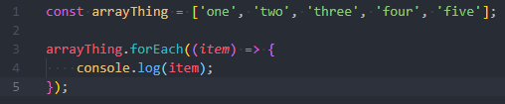


2. Imports… Really…
Hmm…
Better
12% Quicker
Notes:
Slower to execute same functionality
Bigger overall package size
Slower to initially load
Not all packages are required.
Large libraries can often be substituted for simple vanilla functions

Slide 6
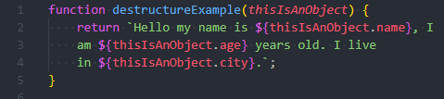

3. Destructuring
Hmm…
Better
Notes:
Choose whether its sensible to destructure
It may be more effective to change what parameter is passed in
Saves repeated code of the same object

Slide 7
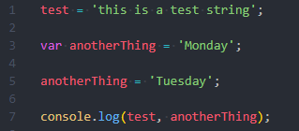
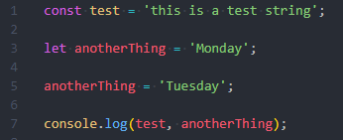
5. Variables
Hmm…
Better
Notes:
Const/Let block level scoped
Const is not truly immutable – object properties can be modified
Const allows for easier code debugging – no looking for hoists/reassignments
There should never be a need to use var
Lots & lots & lots of less bugs
`Specific scope = less errors + improved readability/maintainability.`

Slide 8
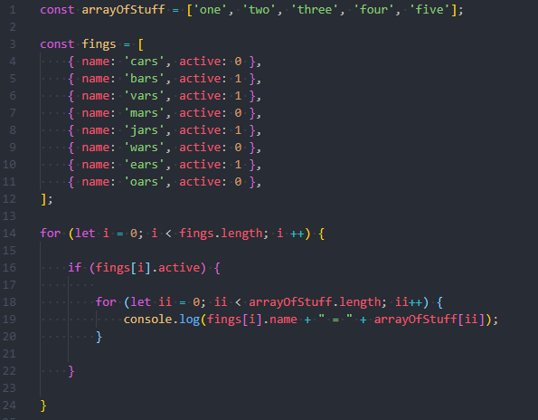
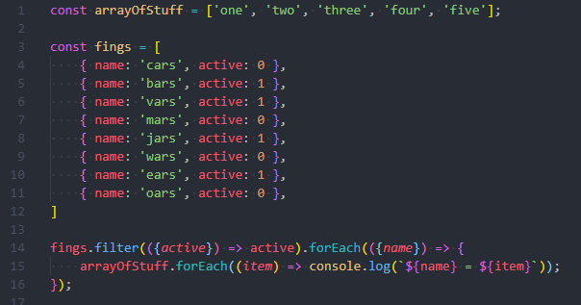
6. Loops – Personal Preference
Hmm…
Better
Notes:
Easier to read
No variable set up
Yes the latter is slower
No when to use the two
The right is a really bad example

Slide 9
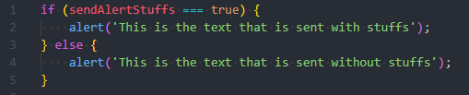
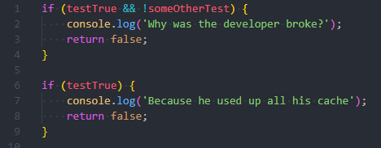
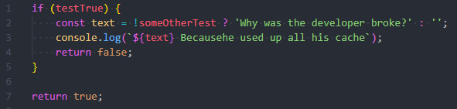
7. Simple Refactors
Hmm…
Better
Notes:
No repeated code
Very slightly quicker to execute
Only an example but in day to day situations can have a large impact

Slide 10
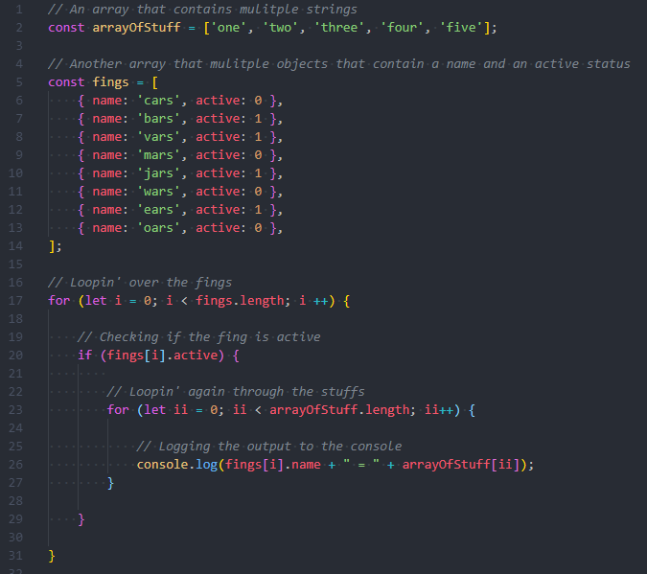
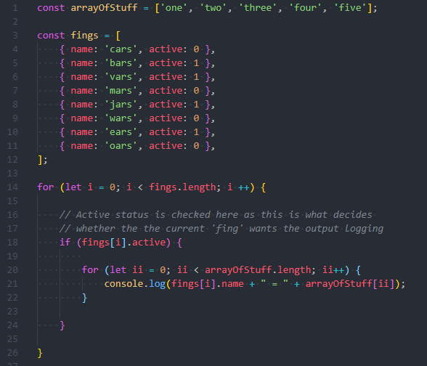
8. Comments
Hmm…
Better
Notes:
Don’t comment for the sake of it
Developers can read code
Comment decisions and reasons behind the code

Slide 11
9.
Don’t use ES6 Classes…
… until you fully understand them
Better
Notes:
Javascript never had a concept of classes – prototypes lead the way
Language to language classes work differently
Don’t jump in and hope for the best
Understand what you’re working with first

Slide 12
10.
Don’t Jump Straight Into Code
Plan Ahead!
Better
Notes:
6 P’s

Slide 13

4.
Pay Attention To Detail
Better

Slide 14
How Do You Comfort A JS Bug?
You console it!
Better

Slide 15
That’s All Folks!
Better

